Slide 1
Executive Summary
Every one wants hot food to eat in offices, colleges, travelling and other working places rather than unhygienic food of market but there is always a problem of hot home made food so we are presenting a innovation for the hot food not by electricity but by hand it is a manual driven lunch box named ECO BOX.

Slide 2
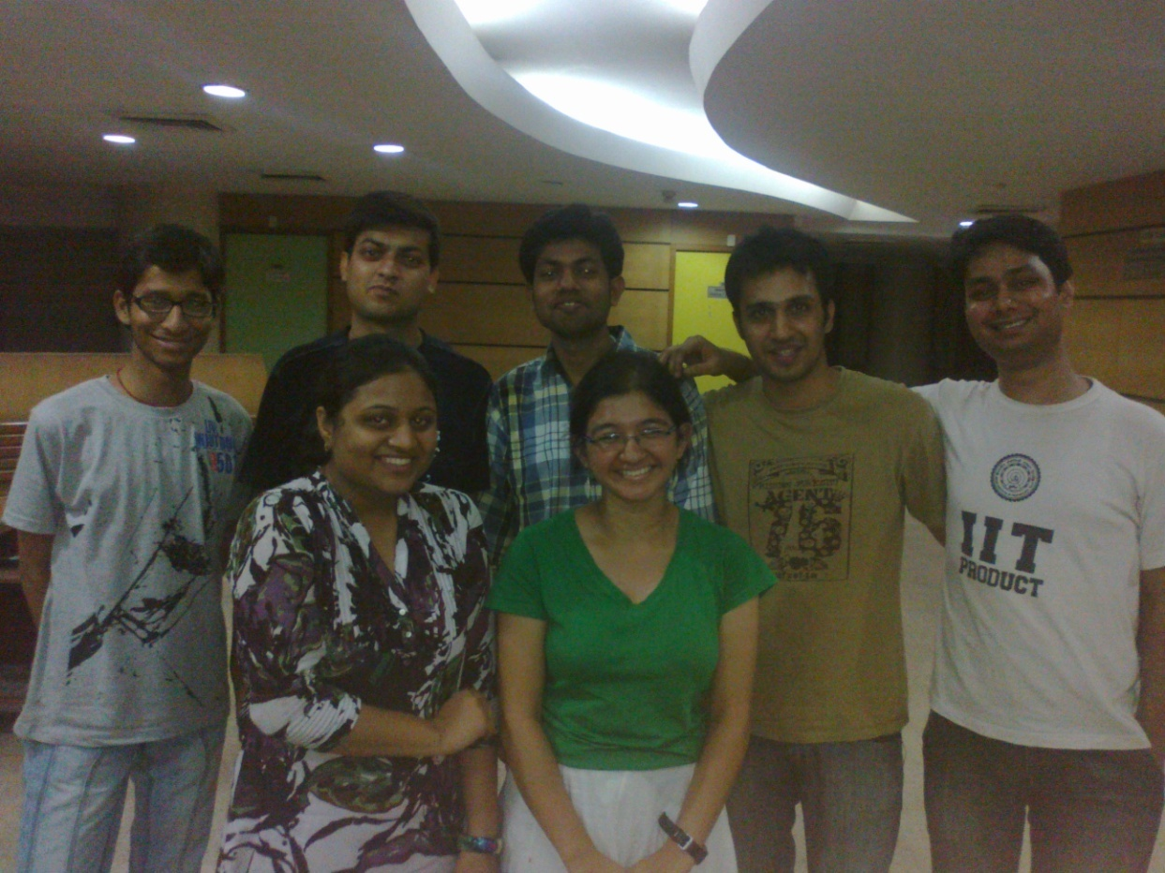
Group-1
The Technovators
Abhishek Agarwal, Alok Arya, Ashish, Himani Galagali, Shubham Ratnam, Toshika Chauhan, Vineet

Slide 3
Top 3 Ideas
Manually driven electric lunch box
Mobile Windmill
Gym Generator

Slide 4
Pain Area
Food does not remain warm.

Slide 5
Why have we chosen this idea?
Impact : Heated food without electric power supply obtained.
Market : Rural areas, military, travellers, full time workers.
Competition : Electric tiffin boxes, solar cookers.

Slide 6
Six Thinking Hats

Slide 7
White Hat
Hot food is tasty.
Weather brings down the temperature of food.
Microwaves, solar cooker and electric tiffin require power supply.
Microwaves are non portable.
Power supply is not available everywhere.
Green Hat
Battery powered tiffins.
Use solar cells as power supply.
Manually driven lunch box.

Slide 8
Red Hat
No one likes to eat food which is not warm!
Homemade food is the best!
Electricity is very costly….if available!
People have to consume unhygienic food while travelling.
How can we find electric plug points while travelling?
Yellow Hat
Eat homemade food in delight.
Solar energy is renewable energy source.
Portable.
Manually driven lunch box does not require extra electricity/cost and gives opportunity to exercise.

Slide 9
Black Hat
Battery leakage will spoil food.
Sunlight is not available everywhere and all the time.
Solar cell powered lunch boxes would be time consuming.
Manual work required.
Blue Hat
Considering the ideas of all the hats, we have come to the conclusion that we need a product that does not require electricity to heat food and can manually generate electricity to heat food.

Slide 10
Eco-Box Rotate, heat n eat!
Lunch Box
USB
Handle
DC Generator

Slide 11
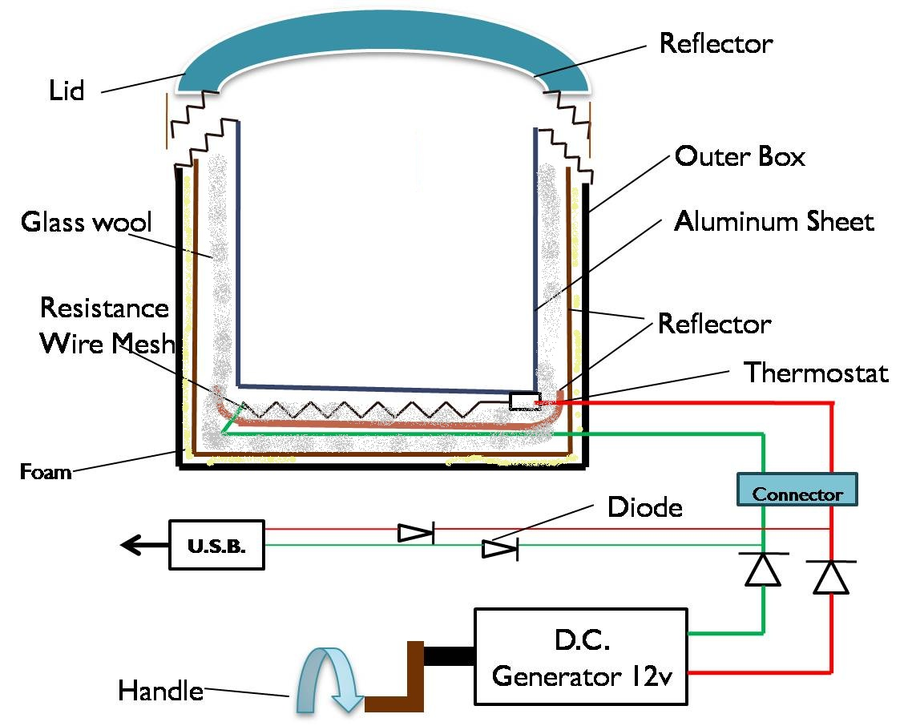
Product Design

Slide 12
Technical Specifications
Aluminum plate - good conductor
Resistance wire mesh – for heating
Reflectors – reflect heat inside
Thermostat – control temperature
Glass wool – for uniform heat distribution
Foam - insulator

Slide 13
Technical Specifications
Outer box (Plastic) - Cover
Connector – to connect generator
USB/Battery Connector - heating from USB
DC Generator – to generate electricity
Diodes – for unidirectional flow of electricity
Lid – for upper cover

Slide 14
Business Plan
What we offer
Our product is not only environment friendly , but also pocket friendly.
Priced at just Rs.
Customers also have the option of paying via installments .
Reliable product : We offer two year warranty on our product .
799 /-

Slide 15
Business Plan
What we accrue
Manufacturing cost i.e. , material cost , labour cost and other expenses ( direct and indirect ) comes out to be Rs. 500 per unit .
This way , we still save around Rs. 300 per unit , which can be used as working capital for future investments .

Slide 16
Financial Help..
Bank Loan
Tie Up with private firm.
Marketing Help
Pre Production Marketing Research
Articles and newsletters
In villages , ‘Panchayats’ and Fairs to reach masses .
Strategies Know-how
Emotion
Awareness
Branding

Slide 17
The Real Leadership Lessons of Steve Jobs
Walter Isaacson
Harvard Business Review

Slide 18
Keys to Success
Focus
Deciding what not to do is as important as deciding what to do
Simplicity comes from conquering underlying challenges, rather than merely ignoring complexity.
Simplify

Slide 19
Key to Success
Take responsibility end to end
Seamless Integration
Don’t merely catch up. Create to transform.
When Behind, LEAPFROG

Slide 20
Key to Success
Put products before profits
Focus on making
great products, profits will follow
Don’t be a slave to focus groups
Use Intuition
over Intellect

Slide 21
Key to Success
Bend Reality
Get your mind around it,
YOU CAN DO IT!!!
People do judge a book by it’s cover.
Impute

Slide 22
Key to Success
Push for Perfection
Take as much
care of the back as the front
Work with the BEST!!!
Tolerate only
“A” players

Slide 23
Key to Success
Engage
Face-to-Face
Creativity comes
from spontaneous meetings, random discussions
Envision overarching strategy while also focusing on the tiniest details
Know both the big picture and the details

Slide 24
Key to Success
Combine humanities with science
Firewire poetry and processors
Business and engineering aspect along with the artistic rebel approach
Stay hungry,
Stay foolish

Slide 25
Thank You!

Slide 26
Group Members
Name | College Name
Abhishek Agarwal | Invertis University Bareilly
Alok Arya
Ashish Anand | Jaipuria Institute of Management
Himani Galagali | Indian Institute of Science
Shubham Ratnam | Faculty Of Engineering, Dayalbgh Eductional Institute
Toshika Chouhan | Ansal Institute of Technology
Vineet Yadav

